Slide 1
Introduction to quantum Hoare logics
Nengkun Yu
FEIT, UTS, Australia

Slide 2
Election Software
If we have C candidates for S<C vacancies you rank all candidates in order of your preference:
Gough, Vladimir, ... , Tony
Counting such ballots proceeds in rounds where in each round we count up the votes for each candidate, elect or eliminate one candidate and then transfer the surplus votes to the next preferred candidate

Slide 3
Election Software
If we have C candidates for S<C vacancies you rank all candidates in order of your preference:
Gough, Vladimir, ... , Tony
Counting such ballots proceeds in rounds where in each round we count up the votes for each candidate, elect or eliminate one candidate and then transfer the surplus votes to the next preferred candidate
The Electoral Commission uses a computer program to count the votes cast for elections
Is it safe?

Slide 4
Election Software
If we have C candidates for S<C vacancies you rank all candidates in order of your preference:
Gough, Vladimir, ... , Tony
Counting such ballots proceeds in rounds where in each round we count up the votes for each candidate, elect or eliminate one candidate and then transfer the surplus votes to the next preferred candidate
The Electoral Commission uses a computer program to count the votes cast for elections
Is it safe?
Bugs? We have found three: all could have changed the outcome!
Verification

Slide 5
What gets verified
Hardware
Compilers
Programs
…

Slide 6
How do we do it?
Informally analysing the code
Testing:
“Program testing can be used to show the presence of bugs, but never to show their absence!” - Edsger Dijkstra
Formal verification

Slide 7
Formal Program Verification
Formal program verification is about proving properties of programs using logic and mathematics:
1. proving they meet their specifications
2. proving that requirements are satisfied

Slide 8
Why verify formally?
Proofs guarantee(partial) correctness of program.
Formal proofs are mechanically checkable.
Good practice for ordinary programming.

Slide 9
Verification for Imperative Languages
Imperative languages are built around a program state(data stored in memory).
Imperative programs are sequences of commands that modify that state.
We need,
A way of expressing assertions about program states.
Rules for manipulating and proving those assertions.
Hoare logic…

Slide 10
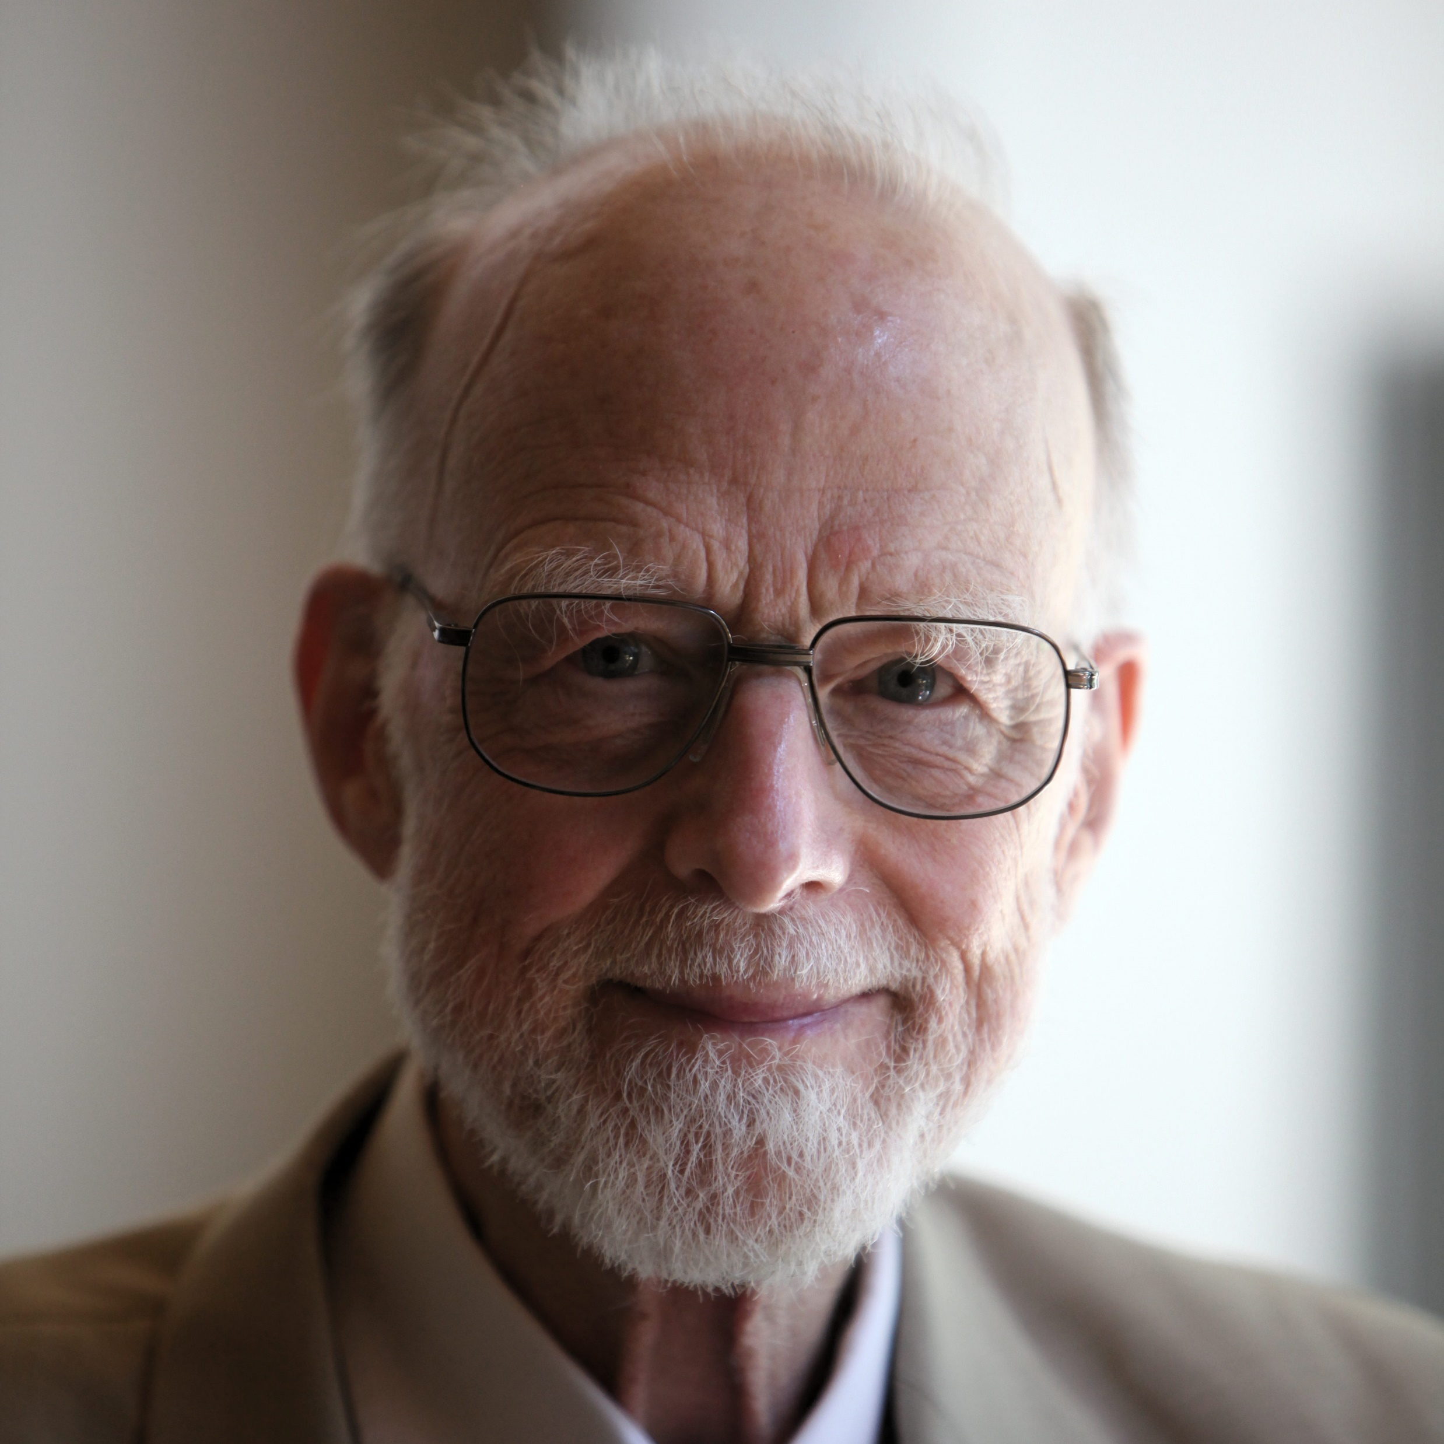
C. A. R. (Tony) Hoare
The inventor of this logic is also famous for inventing the Quick sort algorithm in 1960 - when he was just 26!
“Computer programming is an exact science in that all the properties of a program and all the consequences of executing it in any given environment can, in principle, be found out from the text of the program itself by means of purely deductive reasoning.”

Slide 11
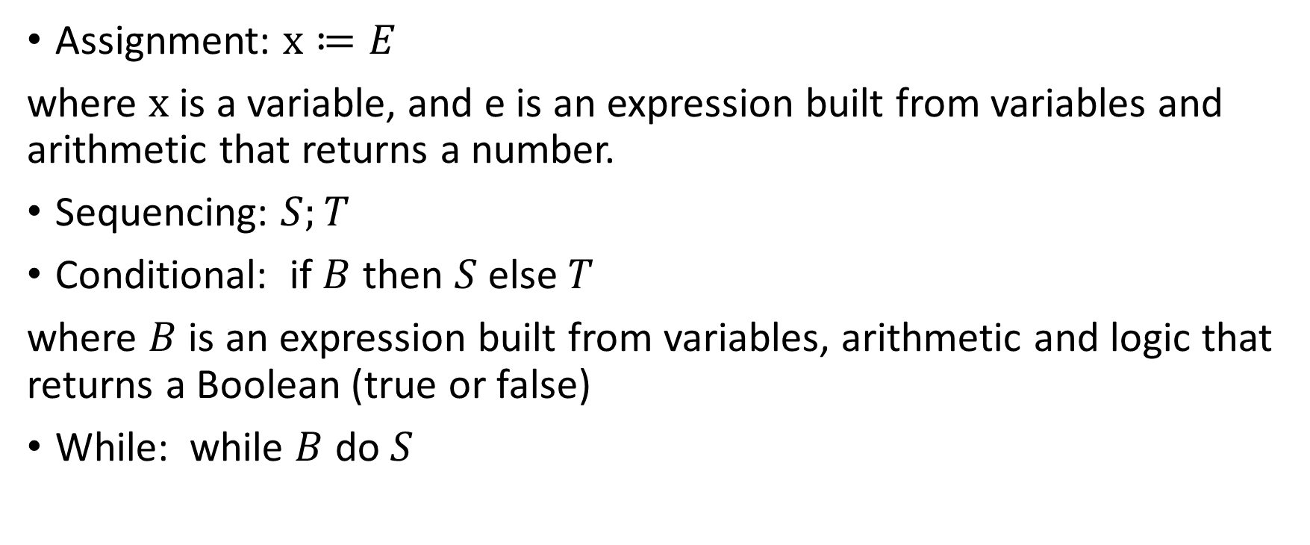
While-Language
Assignment: $x≔E$
where $x$ is a variable, and e is an expression built from variables and arithmetic that returns a number.
Sequencing: $S;T$
Conditional: if $B$ then $S$ else $T$
where $B$ is an expression built from variables, arithmetic and logic that returns a Boolean (true or false)
While: while $B$ do $S$

Slide 12
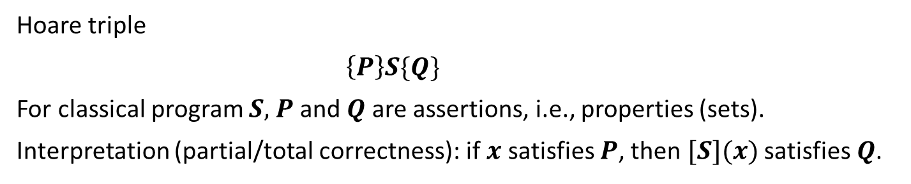
Hoare logic
Hoare triple
$\left\{P\right\}S\{Q\}$
For classical program $S,$ $P$ and $Q$ are assertions, i.e., properties (sets).
Interpretation (partial/total correctness): if $x$ satisfies $P$, then $[S](x)$ satisfies $Q$.
Formal verification: Given $P,S,$ and $Q$, prove or disprove $\left\{P\right\}S\{Q\}$.
$$\left\{x+1=43\right\}y≔x+1\{y=43\}$$

Slide 13
Hoare logic
Hoare triple
$\left\{P\right\}S\{Q\}$
For classical program $S,$ $P$ and $Q$ are assertions, i.e., properties (sets).
Interpretation (partial/total correctness): if $x$ satisfies $P$, then $[S](x)$ satisfies $Q$.
Formal verification: Given $P,S,$ and $Q$, prove or disprove $\left\{P\right\}S\{Q\}$.
the Euclidean algorithm for gcd
{x>0,y>0}
m:=x; n:=y;
while (m≠n) do
if (m<n) then
n:=n-m;
else
m:=m-n;
{m=gcd (x,y)}
Loop invariant: gcd(x,y)=gcd(m,n).

Slide 14
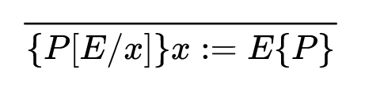
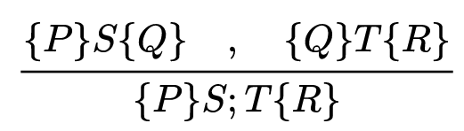
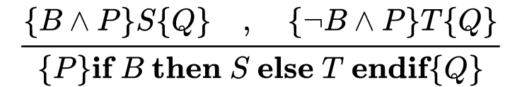
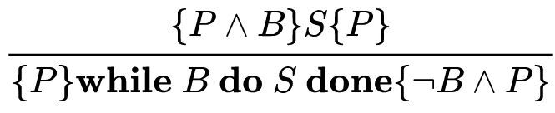
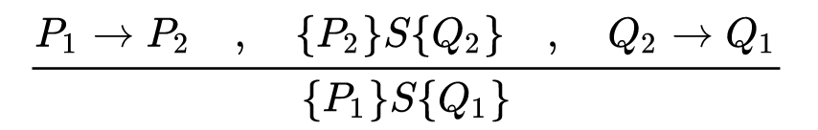
Proof Rules

Slide 15
Hoare Logic for quantum programs?

Slide 16
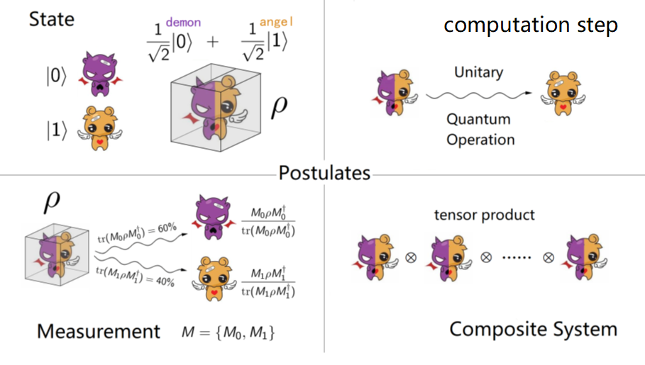
State collapse & Exponential explosion
Measurement collapses quantum state m-qubit system = $2^{m}$-dimensional space

Slide 17
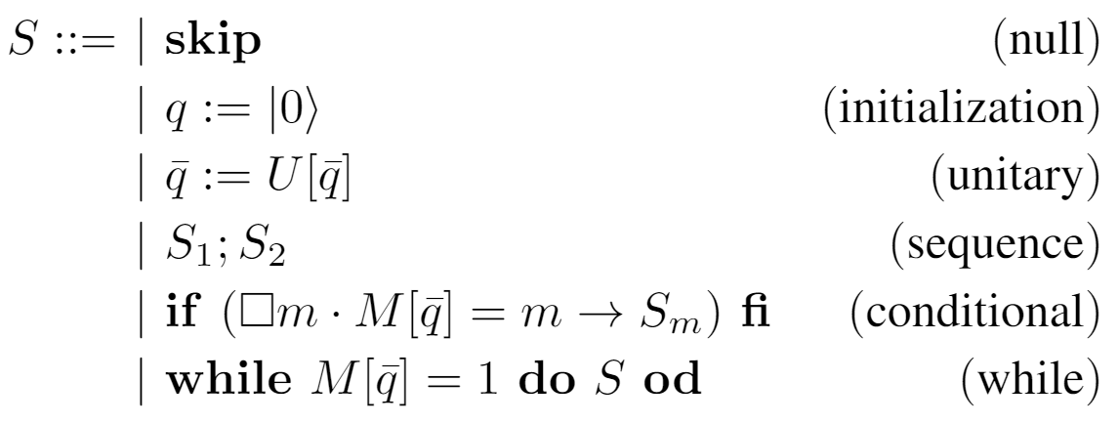
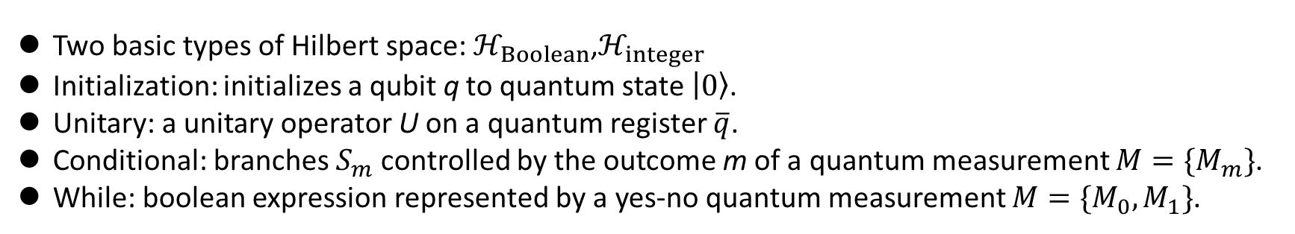
Q-While Language
Figure 1. Syntax for quantum while programs
Two basic types of Hilbert space: $ℋ_{Boolean}$,$ℋ_{integer}$
Initialization: initializes a qubit q to quantum state $\left|\left.0\right\rangle \right.$.
Unitary: a unitary operator U on a quantum register $\overline{q}$.
Conditional: branches $S_{m}$controlled by the outcome m of a quantum measurement $M=\{M_{m}\}$.
While: boolean expression represented by a yes-no quantum measurement $M=\{M_{0},M_{1}\}$.
Repeat-Until-Success, A. Bocharov, M. Roetteler, K. M. Svore, PRL’15

Slide 18
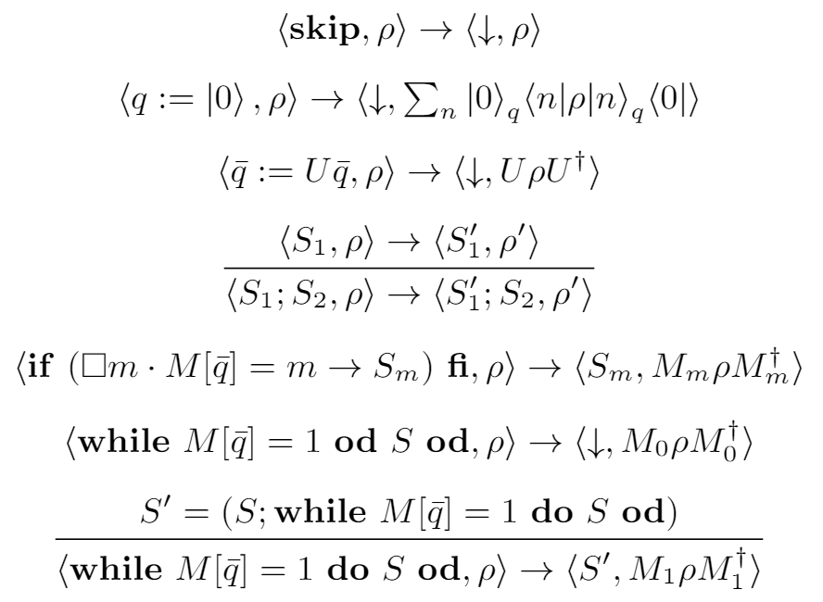
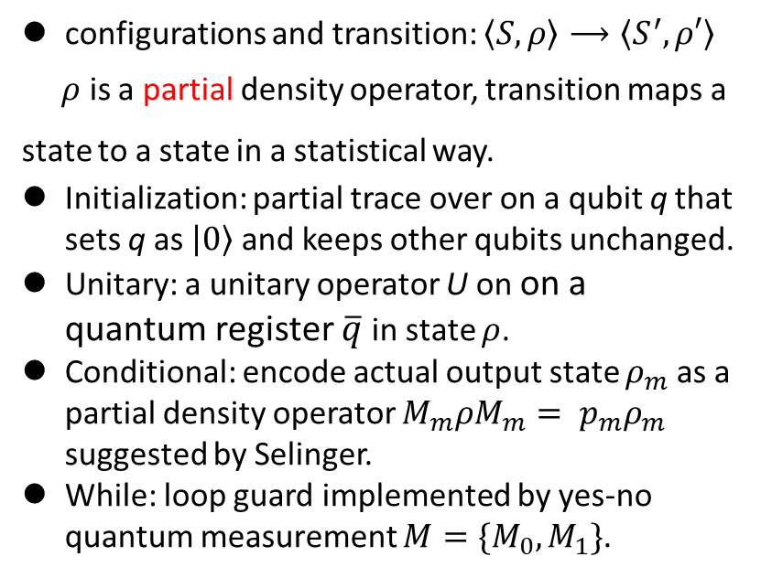
Operational Semantics
configurations and transition: $\left\langle S, ρ\right\rangle ⟶\left\langle S^{′}, ρ′\right\rangle$
$ρ$ is a partial density operator, transition maps a state to a state in a statistical way.
Initialization: partial trace over on a qubit q that sets q as $\left|\left.0\right\rangle \right.$ and keeps other qubits unchanged.
Unitary: a unitary operator U on on a quantum register $\overline{q}$ in state $ρ$.
Conditional: encode actual output state $ρ_{m}$ as a partial density operator $M_{m}ρM_{m}= p_{m}ρ_{m}$ suggested by Selinger.
While: loop guard implemented by yes-no quantum measurement $M=\{M_{0},M_{1}\}$.
Figure 2. Operational Semantics

Slide 19
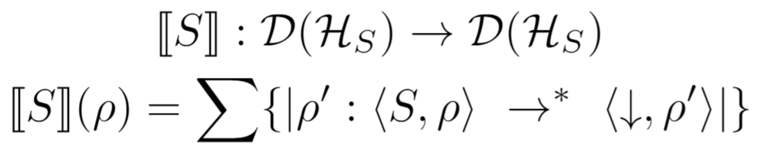
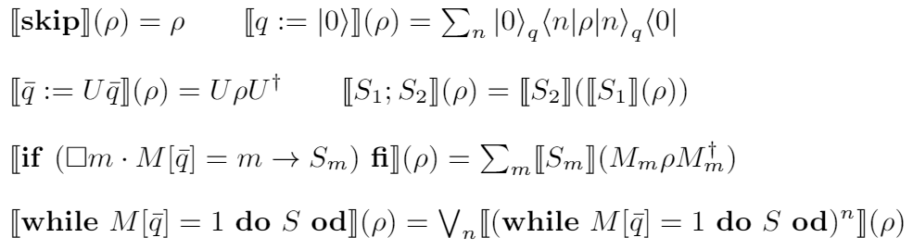

Denotational Semantics
The denotational function is the mapping:
where $𝒟\left(ℋ_{S}\right)$ is the set of partial density operators, $⟶^{∗}$ is the reflexive and transitive closure of $⟶$, and $\left\{\left|∙\right|\right\}$ is a multi-set.
Figure 3. Denotational Semantics

Slide 20
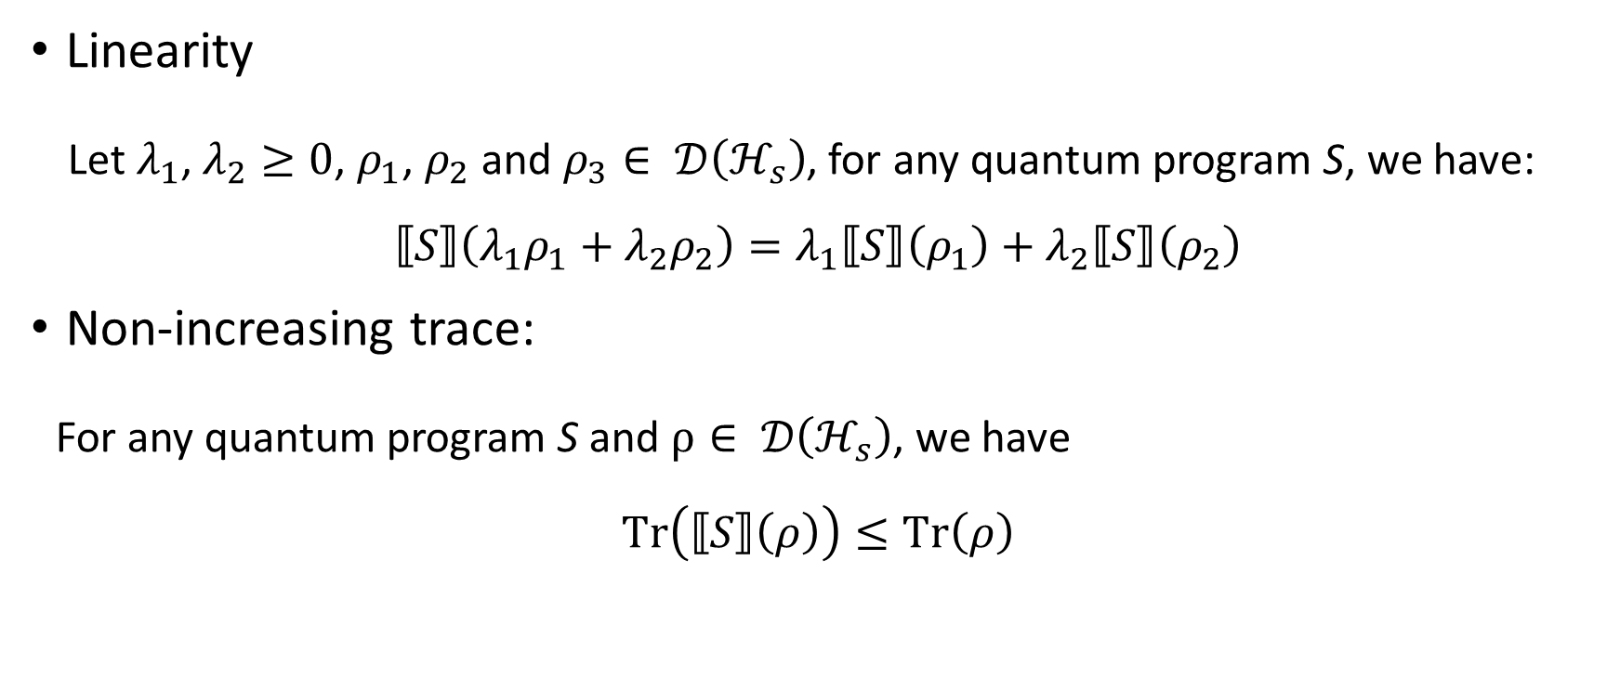
Properties
Linearity
Let $λ_{1}$, $λ_{2}≥0$, $ρ_{1}$, $ρ_{2}$ and $ρ_{3}∈ 𝒟\left(ℋ_{s}\right)$, for any quantum program S, we have:
$$⟦S⟧\left(λ_{1}ρ_{1}+λ_{2}ρ_{2}\right)=λ_{1}⟦S⟧\left(ρ_{1}\right)+λ_{2}⟦S⟧\left(ρ_{2}\right)$$
Non-increasing trace:
For any quantum program S and $ρ∈ 𝒟\left(ℋ_{s}\right)$, we have
$$Tr\left(⟦S⟧\left(ρ\right)\right)≤Tr\left(ρ\right)$$

Slide 21
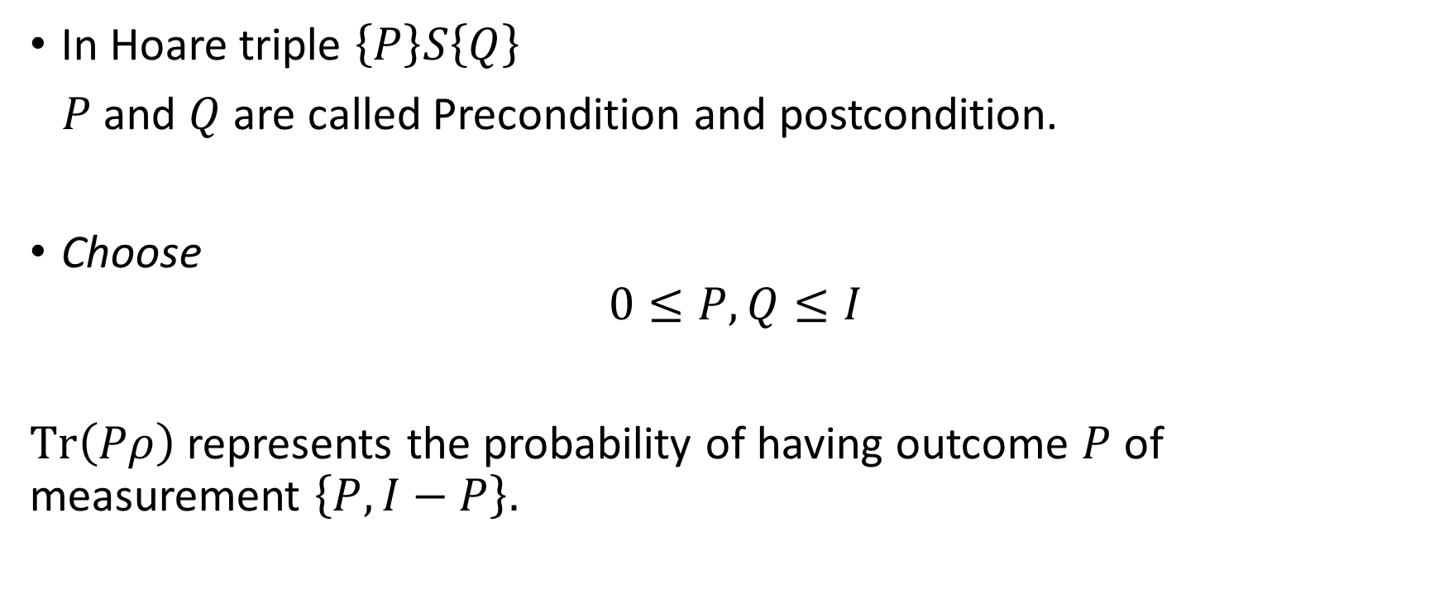
Precondition and postcondition
In Hoare triple $\left\{P\right\}S\left\{Q\right\}$
$P$ and $Q$ are called Precondition and postcondition.
Choose
$$0≤P,Q≤I$$
$Tr\left(Pρ\right)$ represents the probability of having outcome $P$ of measurement $\left\{P,I−P\right\}.$

Slide 22
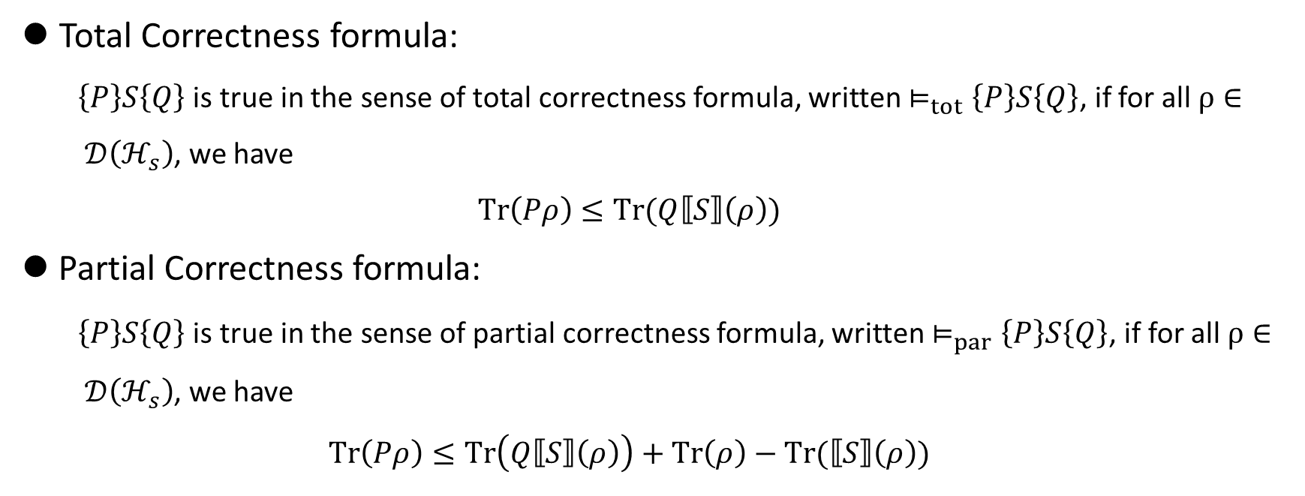
Correctness Formula
Total Correctness formula:
$\left\{P\right\}S\left\{Q\right\}$ is true in the sense of total correctness formula, written $⊨_{tot}\left\{P\right\}S\left\{Q\right\}$, if for all $ρ∈ 𝒟\left(ℋ_{s}\right)$, we have
$$Tr\left(Pρ\right)≤Tr(Q⟦S⟧\left(ρ\right))$$
Partial Correctness formula:
$\left\{P\right\}S\left\{Q\right\}$ is true in the sense of partial correctness formula, written $⊨_{par}\left\{P\right\}S\left\{Q\right\}$, if for all $ρ∈ 𝒟\left(ℋ_{s}\right)$, we have
$$Tr\left(Pρ\right)≤Tr\left(Q⟦S⟧\left(ρ\right)\right)+Tr\left(ρ\right)−Tr(⟦S⟧\left(ρ\right))$$
$Tr(Pρ)$ denotes the probability that the state $ρ$ satisfies the predicate P.
$Tr\left(ρ\right)−Tr(⟦S⟧\left(ρ\right))$ is the probability that quantum program S diverges from input $ρ$.

Slide 23
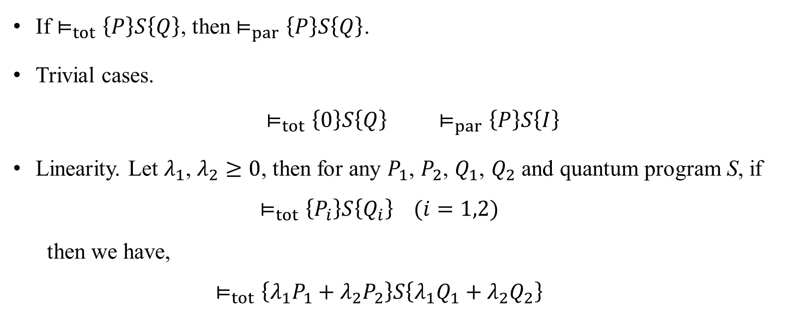
Properties
If $⊨_{tot}\left\{P\right\}S\left\{Q\right\}$, then$⊨_{par}\left\{P\right\}S\left\{Q\right\}$.
Trivial cases.
$⊨_{tot}\left\{0\right\}S\left\{Q\right\}$ $⊨_{par}\left\{P\right\}S\left\{I\right\}$
Linearity. Let $λ_{1}$, $λ_{2}≥0$, then for any $P_{1}$, $P_{2}$, $Q_{1}$, $Q_{2}$ and quantum program S, if
$$⊨_{tot}\left\{P_{i}\right\}S\left\{Q_{i}\right\} (i=1,2)$$
then we have,
$$⊨_{tot}\left\{{λ_{1}P}_{1}+{λ_{2}P}_{2}\right\}S\left\{{λ_{1}Q}_{1}+{λ_{2}Q}_{2}\right\}$$

Slide 24
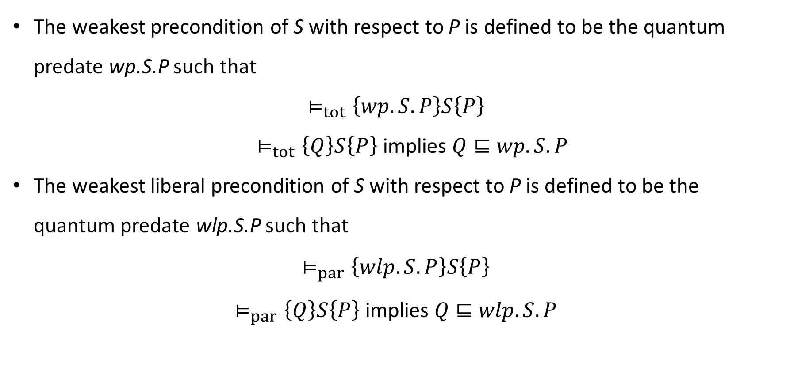
Weakest Precondition
The weakest precondition of S with respect to P is defined to be the quantum predate wp.S.P such that
$$⊨_{tot}\left\{wp.S.P\right\}S\left\{P\right\}$$
$⊨_{tot}\left\{Q\right\}S\left\{P\right\}$ implies $Q⊑wp.S.P$
The weakest liberal precondition of S with respect to P is defined to be the quantum predate wlp.S.P such that
$$⊨_{par}\left\{wlp.S.P\right\}S\left\{P\right\}$$
$⊨_{par}\left\{Q\right\}S\left\{P\right\}$ implies $Q⊑wlp.S.P$
* Löwner order: $A⊑B$ holds iff $Tr(Aρ)⊑Tr(Bρ)$ for all density operators $ρ$.

Slide 25
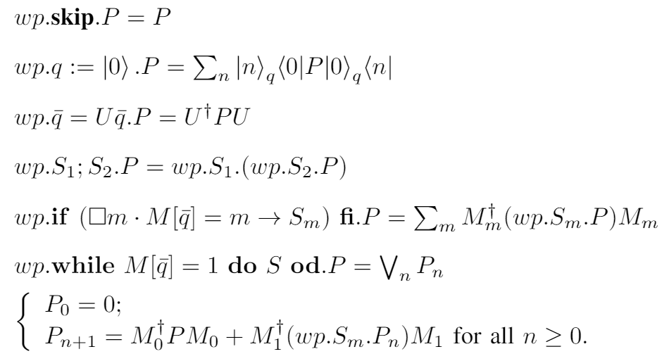
Weakest Precondition
Equality for total correctness formula: $Tr\left((wp.S.P)ρ\right)=Tr(P⟦S⟧\left(ρ\right))$

Slide 26
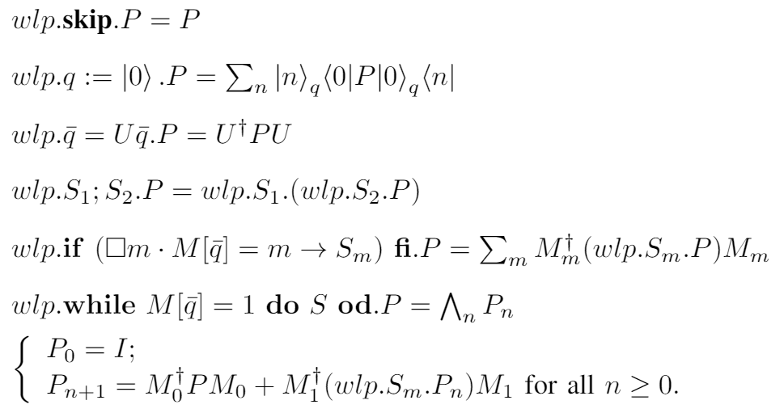
Weakest Precondition
Equality for partial correctness formula: $Tr\left((wlp.S.P)ρ\right)=Tr\left(P⟦S⟧\left(ρ\right)\right)+Tr\left(ρ\right)−Tr(⟦S⟧(ρ))$

Slide 27
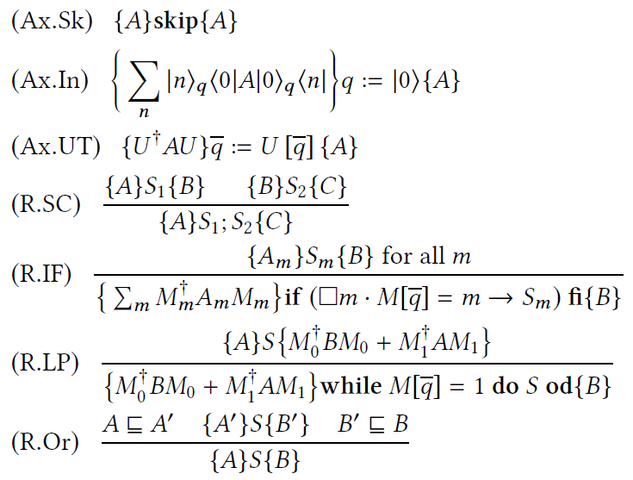
Proof System of Quantum Hoare Logic
Figure 4. Proof system qTD of Total Correctness (sound and complete)

Slide 28
Simpler version?

Slide 29
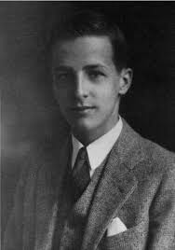
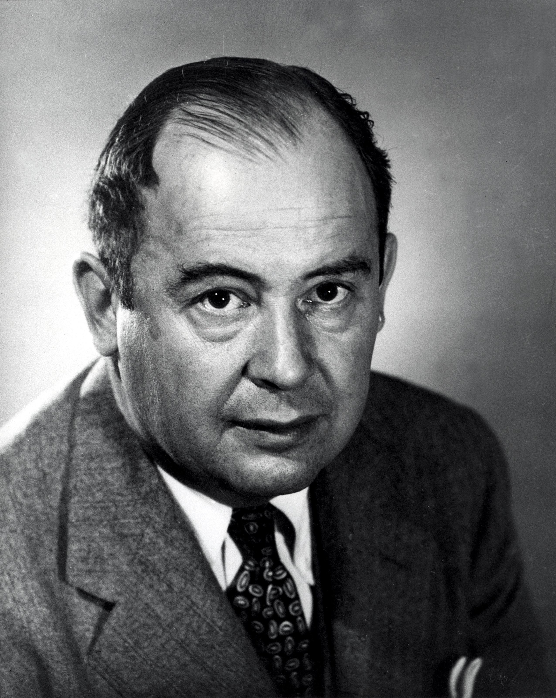
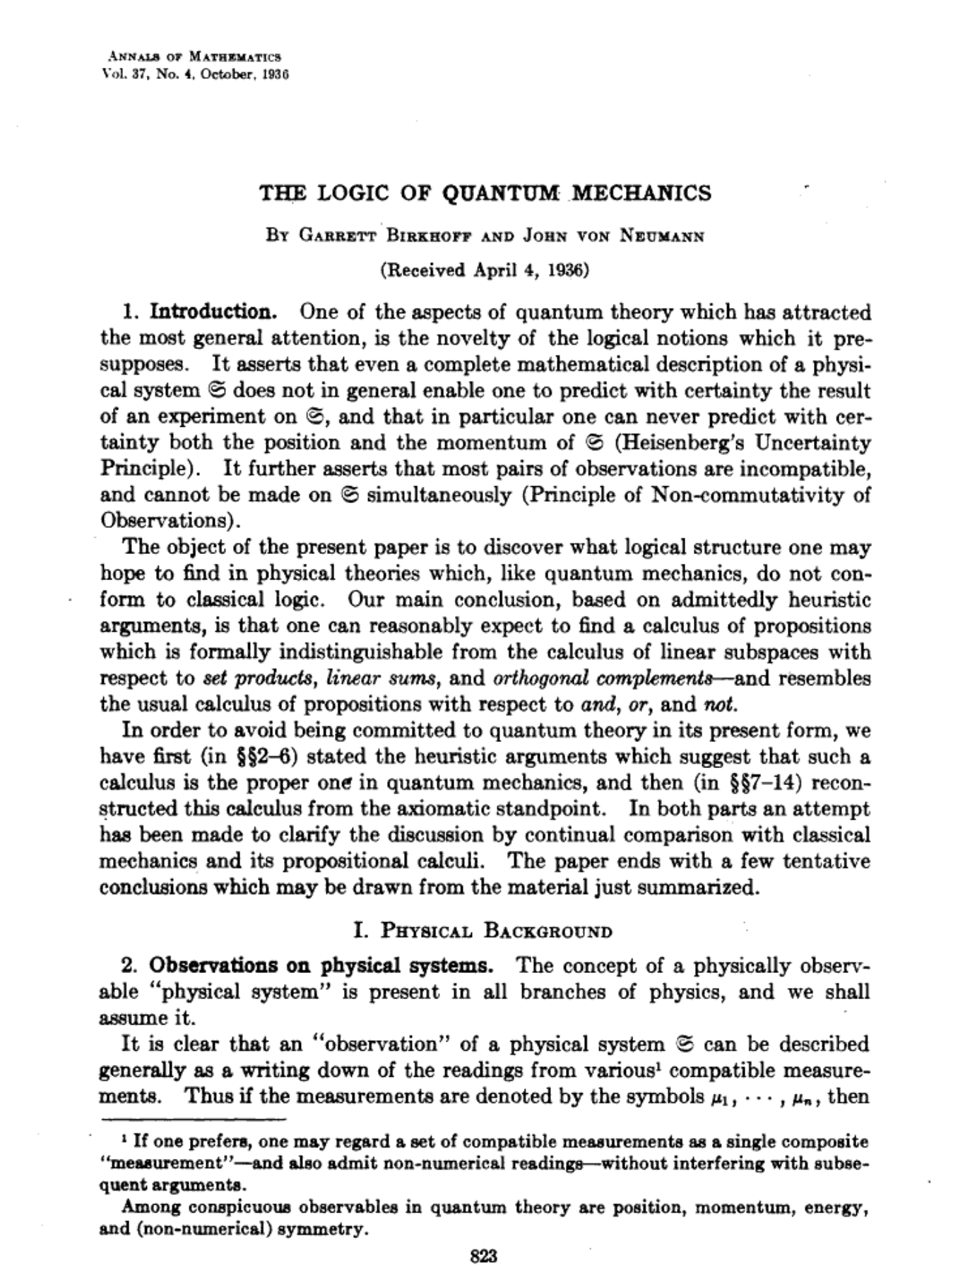




Applied Quantum Hoare Logic
$$\text{ρ}$$
$$P$$
$$P$$

Slide 30

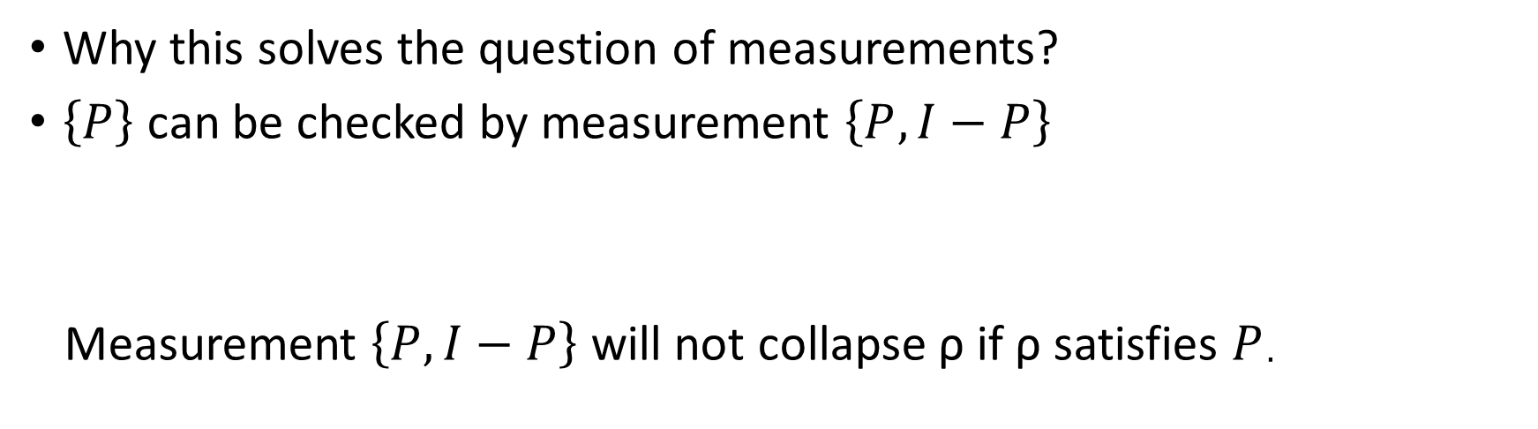





correctness formula
$\left\{P\right\}S\{Q\}$
$$\text{ρ}$$
$$\text{[}\text{S}\text{](}\text{ρ}\text{)}$$
$$P$$
$$Q$$
Why this solves the question of measurements?
$\left\{P\right\}$ can be checked by measurement $\left\{P,I−P\right\}$
Measurement $\left\{P,I−P\right\}$ will not collapse $\text{ρ}$ if $\text{ρ}$ satisfies $P$.

Slide 31
aQHL
Sound and (relatively) complete proof system (for projective assertions.)
For Skip and Unitary

Slide 32
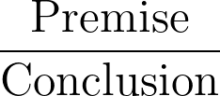
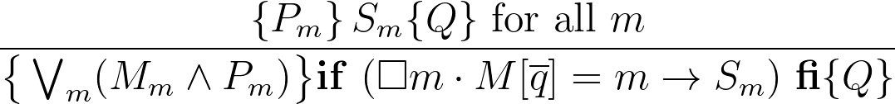



aQHL
Sound and (relatively) complete proof system (for projective assertions.)
For Skip and Unitary
For if statement,

Slide 33
aQHL
Sound and (relatively) complete proof system (for projective assertions.)
For Skip and Unitary
For if statement,
+loop rule-infinite branches

Slide 34
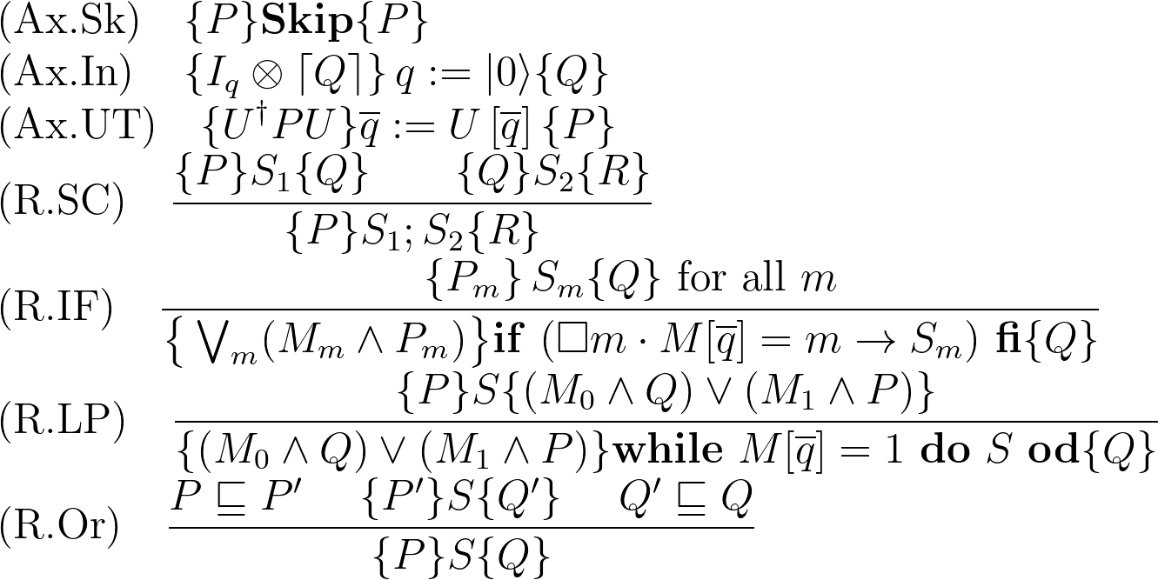
Proof System

